Slide 1
TASK 1
Vulnerability labs

Slide 2
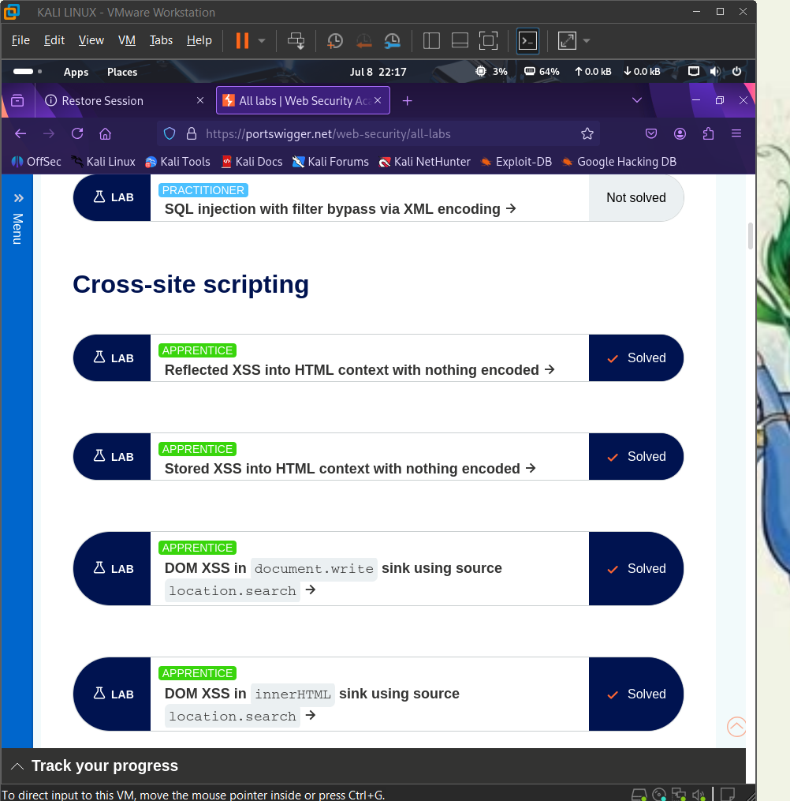

Slide 3
